Slide 1

Concept Prototype N - Developer workshop San Francisco February 10th Robert McCain

Slide 2
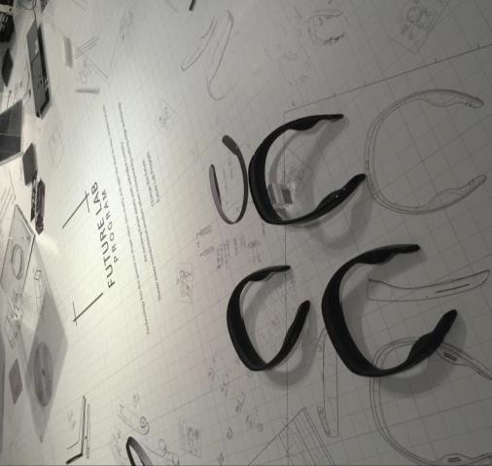

What is the Future Lab Program?
The Future Lab Program from Sony is a new kind of research and development initiative that embraces an approach to technological research and development emphasizing an open creative environment and direct lines of communication with society. Through this approach, it aims to co-create new future lifestyles and enhance user value. As part of this approach, the program will share concept prototypes with users while still at the development stage, and look to them for inspiration, leveraging their feedback to refine and evolve its projects.
Notes:
The Future Lab Program from Sony is a new kind of research and development initiative that embraces an approach to technological research and development emphasizing an open creative environment and direct lines of communication with society. Through this approach, it aims to co-create new future lifestyles and user value.
As part of this approach, the program will share concept prototypes with users while still at the development stage, and look to them for inspiration, leveraging their feedback to refine and evolve its projects.

Slide 3
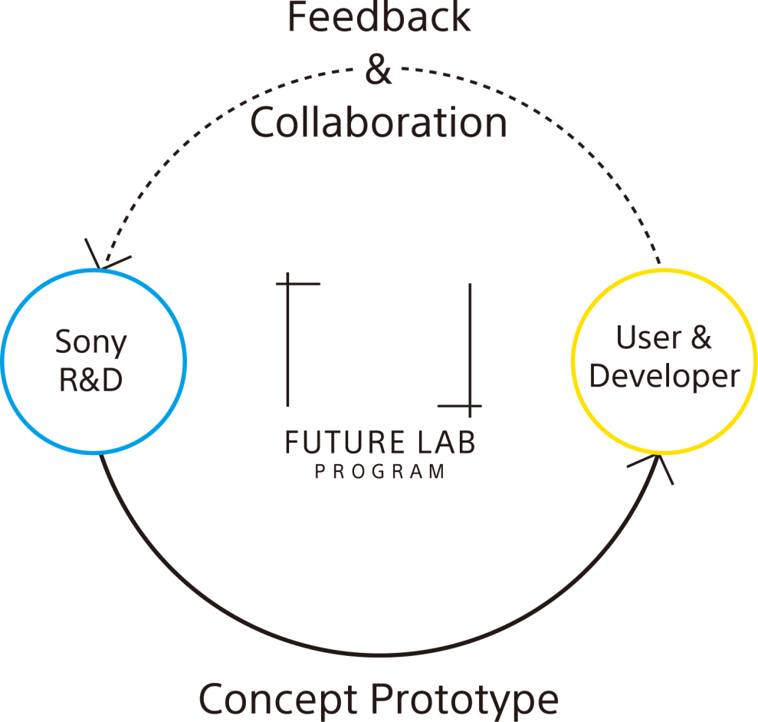
Concept of Future Lab Program
Notes:
We start with R&D and then build a concept prototype
We then bring in users to try out the products
After our users have tried the products for a while we have a round of feedback & collaboration with the team creating the product
We then take that feed back, go back in to R&D and the cycle continues
We actually just had a meetup group 2 days ago where we showed members of the Concept N program some new features based off of their feedback.
For instance being able to take voice calls with the device and the ability to stop segments by long pressing the voice control button.

Slide 4


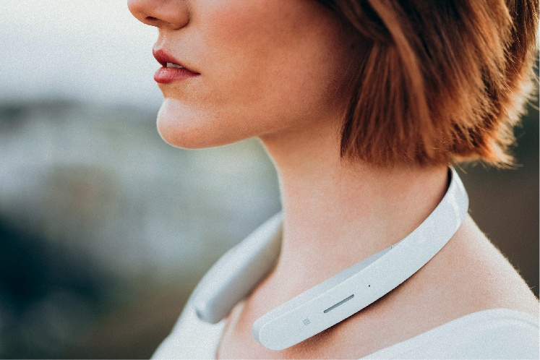
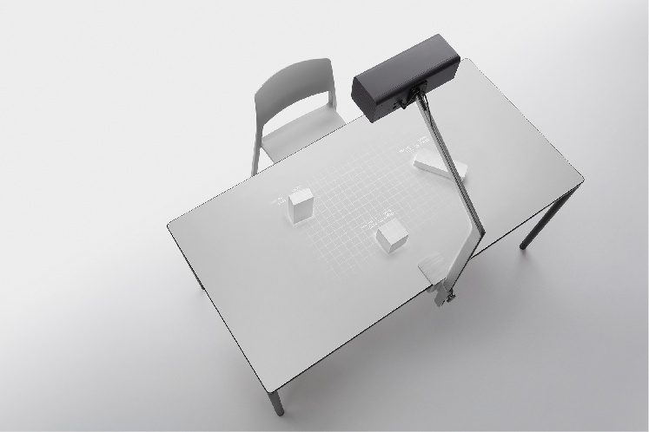
Concept Prototype
Notes:
Currently we have 2 concept prototypes in the program. Concept N which you will be hacking on today and Concept T which if an interactive table based projector

Slide 5


concept “N”
"N" symbolizes the target Sony’s Future Lab Program is aiming for.
"N," is an experience featuring a hands-free user interface that creates a new way of experiencing audio such as music and sound, allowing the user to receive audio information without having to insert anything into his or her ear.

Slide 6

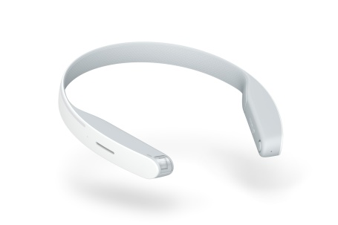
Neckband-style wearable device
N’s innovative open-air speaker system provides a hands-free option for enjoying high-quality sound any time, anywhere.
Notes:
The neckband is equipped with open speakers and responds to voice prompts, making it a new breed of a wearable device that requires no earpiece and realizes a fully hands-free operation.
Designed to fit snugly around the neck, the concept prototype N envelops the user in a cloak of sound with natural sound image localization through Virtualphones Technology (VPT™), and enables the user to acquire audio information anytime with ease.
The neckband achieves highly responsive hands-free operation thanks to Sony’s unique local and cloud hybrid speech recognition technology. Speech recognition performance is boosted by the device’s acoustic beamforming technology utilizing its 4 microphones, resulting in reduced noise and greater accuracy of sound collection.
Additionally, the prototype includes behavior recognition technology driven by the device’s motion sensing and GPS location tracking capabilities. The combination of behavior recognition with Sony’s services allows the concept prototype N to deliver timely information to the user. The concept prototype N also features a built-in camera, which boasts automatic angle adjustment that can take photographs in response to speech commands.

Slide 7
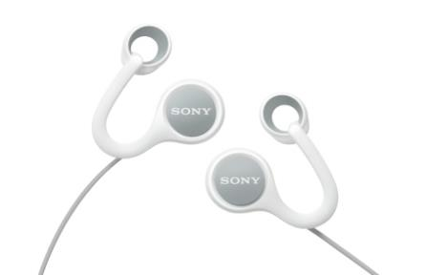
Open-ear earphones
With N's open-ear earphones, you can listen to your favorite music, news and weather updates at your preferred volume while still hearing the sounds of the world around you.
Notes:
This device is an entirely new breed of earphones: an open-ear type. It is equipped with sound duct’s specially designed with Sony’s audio technology, and it controls the audio properties through a combination of this acoustic conductor technology with Clear Phase™ and xLOUD™, Sony’s unique audio signal processing technologies.
With these uniquely crafted earphones, the user can hear ambient sound without obstruction, leaving communication unimpeded. The device is light and comfortable, so the user can leave it on all day and pleasantly enjoy music or request audio information at any time.

Slide 8
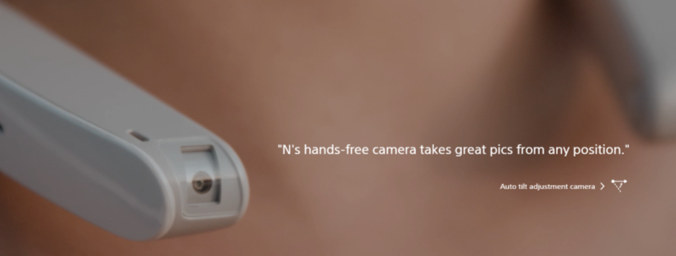
Camera function
Concept prototype N also features a built-in camera, which boasts automatic
angle adjustment that can take photographs in response to speech commands.

Slide 9







Personalized radio service
Personalized Radio Service automatically provides information like a personal assistant, according to the user’s location and activities.
Keep up-to-date with schedule, mail, and news notifications
Explore locally with weather, restaurant, and event info
The user can also get this information with speech commands.
Notes:
This service leverages the behavior recognition technology equipped in the concept prototype N in order to provide the user with timely audio information based on the user’s surroundings or location, or in response to a voice command. This information is conveyed in a fun and upbeat manner, as if the concept prototype N were the user’s own personal radio DJ. Examples of audio information the prototype might provide are the user’s schedule, a weather report, news tailored to the user’s tastes and interests, and information on nearby restaurants and events.

Slide 10
Why develop segments for concept prototype N?
Test your segment on a active user group
Gather user data
Marketing opportunities with Sony at big events
Access to Sony concepts – Try out new technology
Monetize on your data

Slide 11
Challenge Overview

Slide 12
Challenge Overview
During this challenge you will use the SDK and build javascript based apps. Many support tools will be available, such as a simulator, easy to use online documentation, and a quick start guide created specifically for this challenge. Creative concepts are always welcome, but some things we would like to see are:
An app that showcases the hands-free concept.
An app that can utilize a users’ behavior like riding a bicycle, walking, standing, etc...
New Speech-to-text API integration. Speech-to-text functionality will be opened during the hackathon.
Best integration with an API from another sponsor.
Notes:
Sponsor – There are many great sponsors and API’s here today. We would love to see how you can make the N device work with another sponsors API.

Slide 13
Prizes
We are giving away $7,200 dollars in prizes for our challenge. Here is what you can win:
We are giving away 8 Playstation VR bundles for this hack. Retail value is $800 dollars per bundle. We will continue to give bundles out to the winning teams until all bundles are distributed. The bundle includes
The Playstation VR headset
The Playstation camera
2 move controllers
1 Playstation controller
Free membership in to the Future Lab for N program
Notes:
The bundle includes everything you need to start enjoying the playstation VR experience.

Slide 14
SDK for N Overview

Slide 15
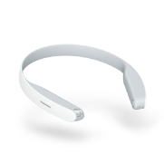
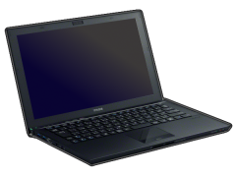

Development flow
Implement a segment in any editor
Test on Segment Developer Tools (Simulator) on Mac or PC
Install to N via distribution site and test on real device.
3.Install and test on real device
Corner
Corner
segment
1.Implement segment
segment
Personalized Radio Service
Simulator
N
2.Test on Simulator
Developer

Slide 16
SDK Overview
The purpose of this section is to give an overview of what you can do with SDK for N.
This will cover:
Code Base
Callbacks that you can create listeners for
Functions available from N
Interval based events
Speech activation
New Speech to Text API

Slide 17
Code Base
You will create N segments using Javascript along with json based configuration files for presenting users with the ability to change settings within your segment and giving your segment the ability to control different aspects of the N device.
You will also be able to use normal Javascript functions for internet access allowing you to pull data from whatever source that is available to you.

Slide 18
Callbacks
With N you can perform actions based on contextual changes. N allows you to listen for these changes and then have your code run once a change happens. Contextual changes include:
Arriving at home / Leaving home
Arriving at work / Leaving work
Walking
Running
Riding a bike
Riding in a car
Switching to a non moving state
In addition to this you can request the user’s current context at anytime and receive one of the above contexts

Slide 19
Functions available from N
Some of the things the N device gives you access to are:
The user’s current geo-location
You will have the ability to have N Speak commands
Using the new speech-to-text API you can create something like a conversational experience.
You will have the ability to save strings using N API’s

Slide 20
Interval based events
With N you will be able to have events fire at an interval specified by you the developer. For example, you can have the device wake up and run a set of code every 10 minutes

Slide 21
Speech Activation
With N you will be able to have your segment activated by voice. Listening mode for Concept N will start by saying “Listen up Nigel” or by pressing the voice input button on the device. At this point if a user speaks your segments launch phrase then your segment starts. For instance, your weather segment could be started like this:
Listen up Nigel....
“Check weather”
“Check weather at home”
“What is the current temperature?”
“Start weather tracker”
Etc...

Slide 22
New Speech to text interaction
Recently added to Concept N is a new Speech to Text API. This API will allow you to start listening for speech input and build interactions around the response. As an example:
Reply to currently read email
User "Listen up Nigel.... Reply to the mail" Nigel "Replying to Samantha, please say the message." User "I will be there in 10 minutes." Nigel "Replying to Samantha with your message, "I will be there in 10 minutes". Ready to send the message?
User “Yes”
Nigel “sent the message to Samantha. “
Notes:
We actually have a very cool concept showing how you can use concept N to perform translations. Take a look at these 2 quick videos of the the feature in action

Slide 23
New segment development
Notes:
To inspire you I want to show you some segments that already exist on the device as well as some that are in development

Slide 24
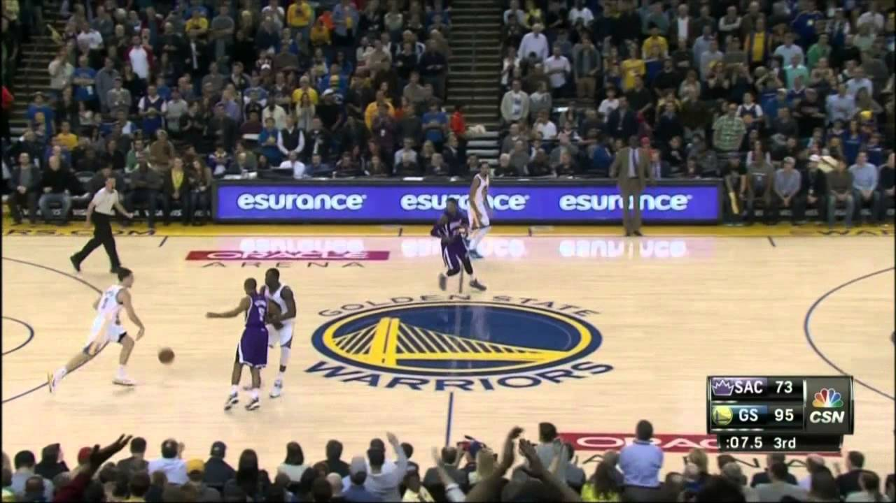




Segment: NBA
Delivers your favorite NBA team updates. Remind’s you of today’s game schedule. Notifies you of the current game score.

Slide 25
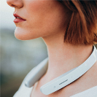
Demo (NBA)
1. Game remainder
2. Play-by-Play update
Warriors plays against Lakers at Staples Center. The game is scheduled for today at 7:30 pm.
D'Angelo Russell makes three point jump shot. Warriors lead Lakers 45:42.
Notes:
As an example you can be reminded of what time the game starts as well as receive play by play updates if you are not able to catch the game. All without having to reach for anything or look away from your current activity

Slide 26

Segment: The Little Boosts
Delivers meaningful boosts and tips throughout the day based on your location and activity.
Notes:
I personally have received some great quotes to get my day started

Slide 27

Segment: Local Guide
Delivers local venue information. (shop, park, museum, etc.)
Notes:
This segment gives you information about the neighborhood depending on where you are…

Slide 28
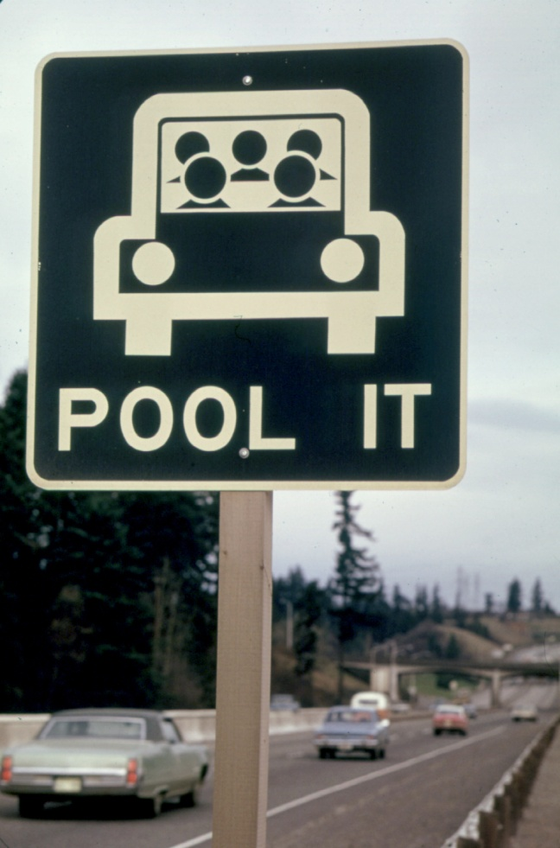

Segment: Traffic
Segment: Ride Sharing
Notes:
And lastly, wouldn’t it be great if nigel could give us traffic updates, next bart schedule based on your location. The list goes on and on

Slide 29





How does it work?
Concept Prototype N
<<INPUT>>
Game Schedule, Play By Play
Ride Request
Nearby Venues / Sights
Cloud
Ask
Voice Recognition
App(Web)
Weather
Web API
Sense
Context
Sensing
Restaurants
Play
Calendar
Music
Player
NBA
Response
Speech
Local Guide
Schedule, Box score
Venue List
Time and Fare Estimation
TTS
Traffic
<<OUTPUT>>
…
D'Angelo Russell makes three point jump shot. Warriors lead Lakers 45:42.
Other Services
You’re now entering SF’s Haight-Ashbury district. Check out … <place to go>
News
Weather
Restaurants
Calendar
Notes:
Concept N receives input from either speech or from device information like context, location, etc…
The device then launches the appropriate segment and the segment retrieves the relevant information either locally or from the cloud.
Once the information is processed the segment then sends the input back to the user, usually through text to speech.
Now that you are familiar with Concept N and what it can do you are ready to spend time getting your development environment setup, learning the platform, reading the documentation and so on.
Well... Normally things would work like that. However we know that this is a hackathon, that you only have 24 hours, and honestly one of the most valuable thing to us is your creative ideas.

Slide 30
Quick Start Guide
Notes:
That is why for this hack we have done the setup for you and created a quick start guide

Slide 31
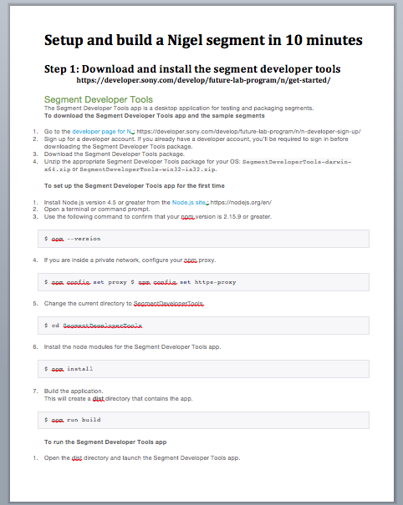
Build your first segment in 5 minutes
To make getting started with Concept N development a bit easier we have created a quick start guide that should help you setup your environment and begin coding in no time
Once you have signed up to be a Concept N developer we will provide you with a Sony branded USB stick with this and all other necessary items you need to get going quickly.
The goal is to free you to be creative without the platform getting in the way.
Notes:
On the USB Stick we have already pre-compiled the simulator, downloaded all of the sample code including everything you need to use the new Speech-to-text API and created a guide giving you everything you need to use these tools and have your first code sample running in 5 minutes or less.
Now I must apologize because the guide says build your first segment in 10 minutes. However we made the decision to pre-compile the simulator, which is really just running some nodejs commands to download files, so the process of having code you can start playing with should take no more than 5 minutes.

Slide 32

Notes:
Now the rest is up to you. We will here to support you throughout the hack so bring your ideas of all shapes and sizes and we will do our best to help you turn that concept in to a reality.

Slide 33
Thank you for coming and Good Luck
Notes:
If there is still time left I will give the developers a preview of the tools they will use to build segments using the following Hands on Training Guide

Slide 34
HANDS ON TRAINING

Slide 35
Steps
Sign up as a N SDK developer
Download the SDK and install the simulator
Run the hello world sample on the simulator
Update the hello world segment to return data from an external source
https://developer.sony.com/develop/future-lab-program/n/

Slide 36
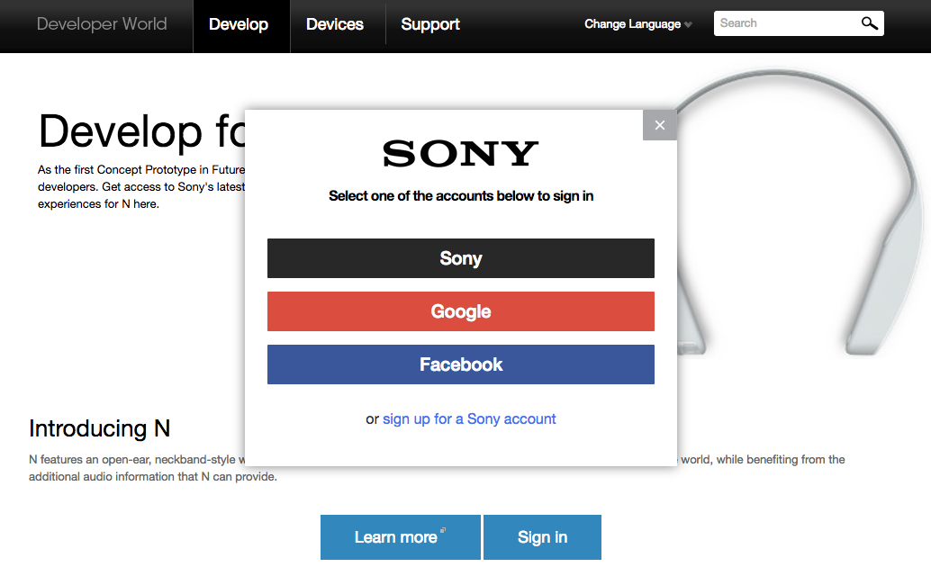
Sign up as a N SDK Developer
https://developer.sony.com/develop/future-lab-program/n/

Slide 37
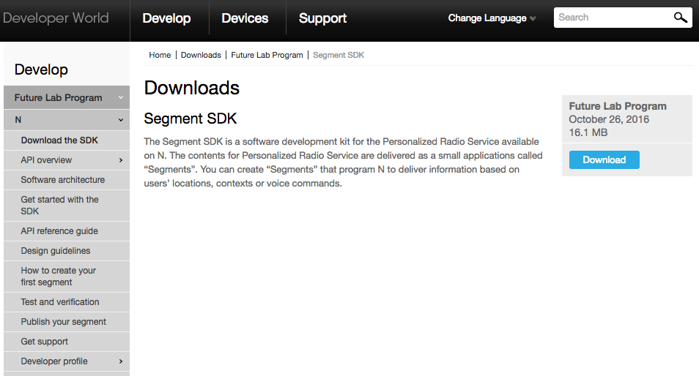
Download the N SDK
https://developer.sony.com/downloads/future-lab-program-2/sdk-for-n/

Slide 38
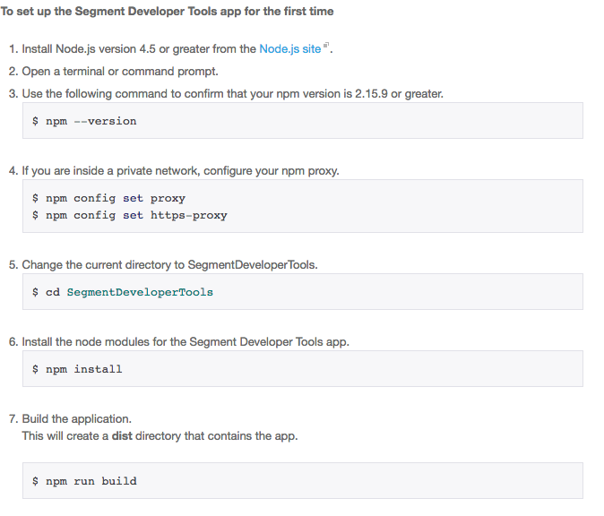
Setup the Segment Developer tools app
https://developer.sony.com/develop/future-lab-program/n/get-started/

Slide 39
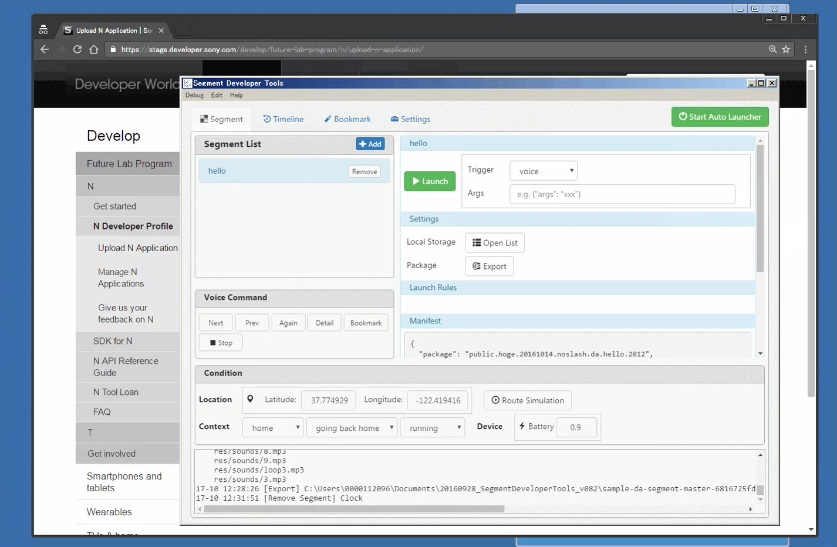
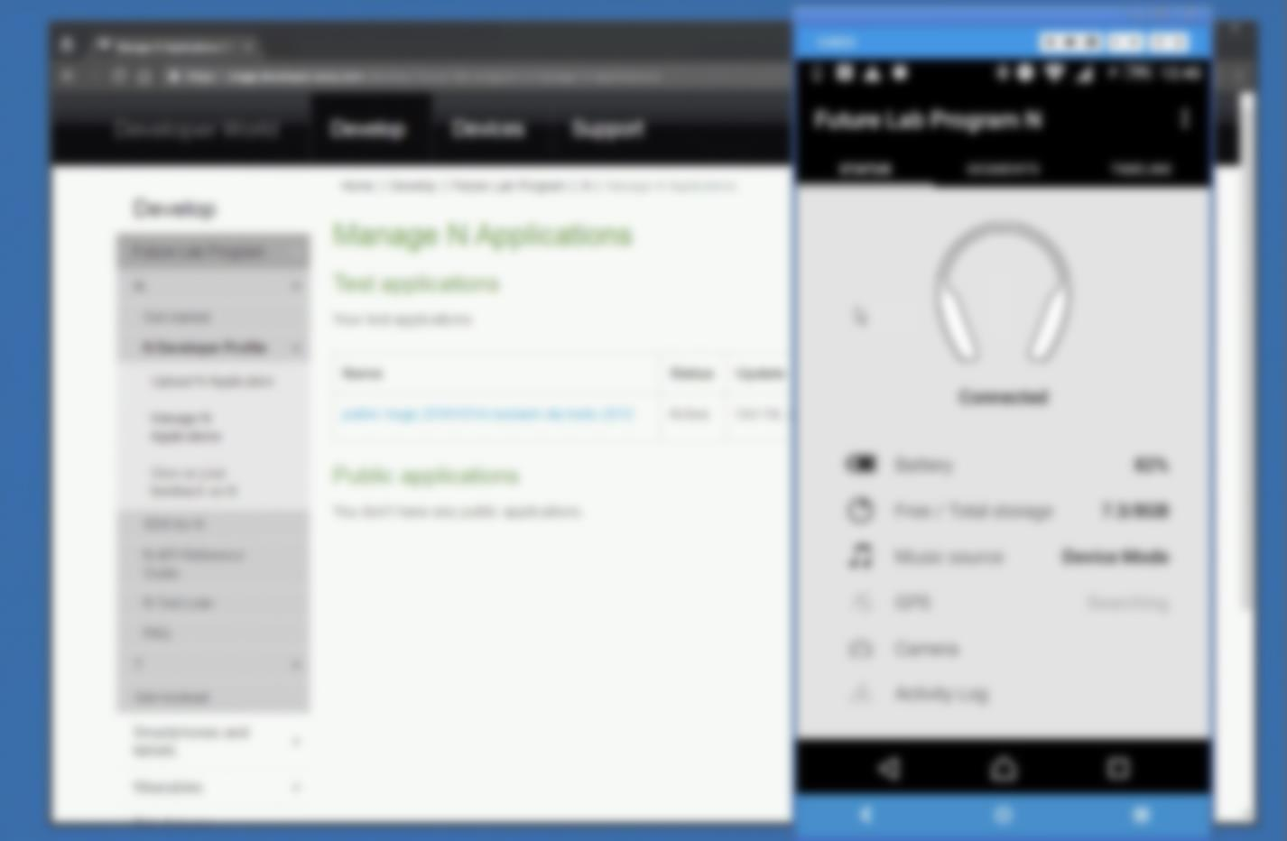
Launch Segment Developer Tools

Slide 40
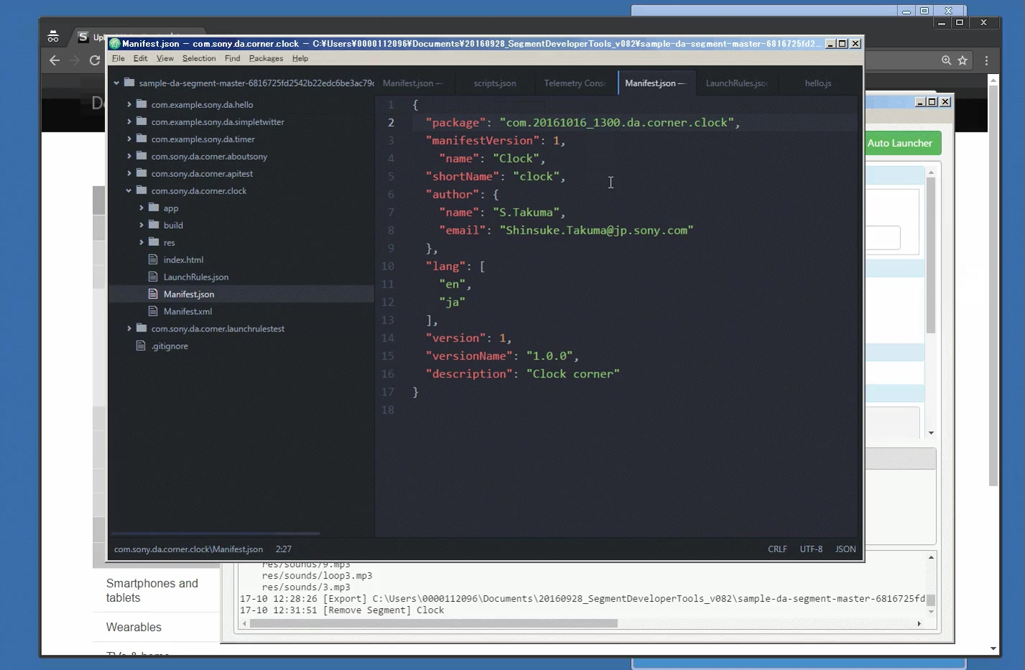
Edit Sample Segment Application(Hello Segment)

Slide 41
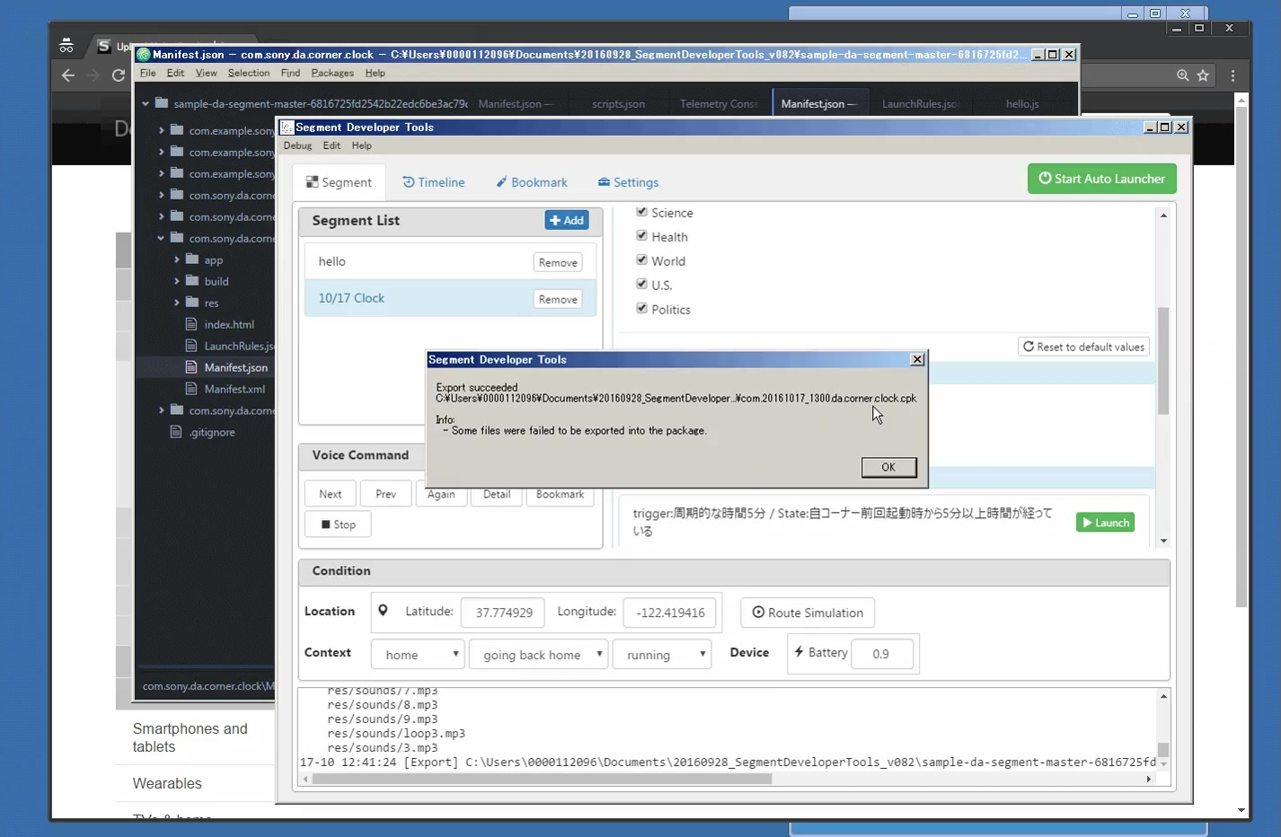
Export Segment Application(cpk file)

Slide 42
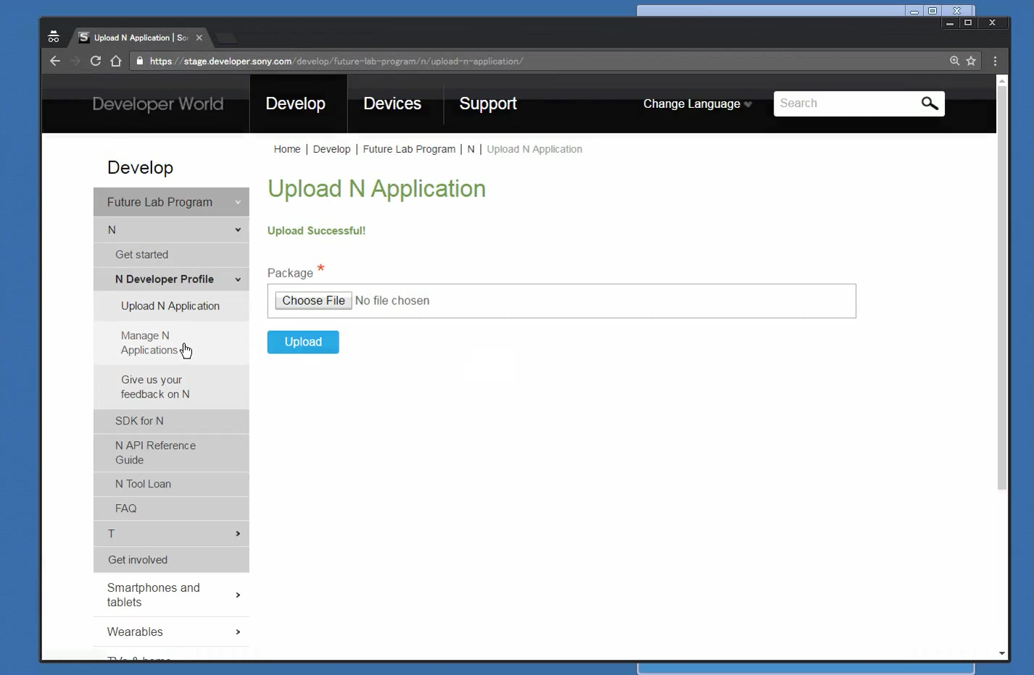
Upload Segment Application

Slide 43
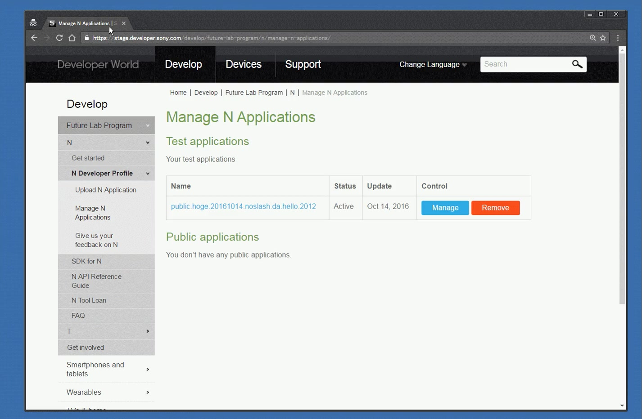
Manage Segment Application page

Slide 44

Launch Host Application

Slide 45
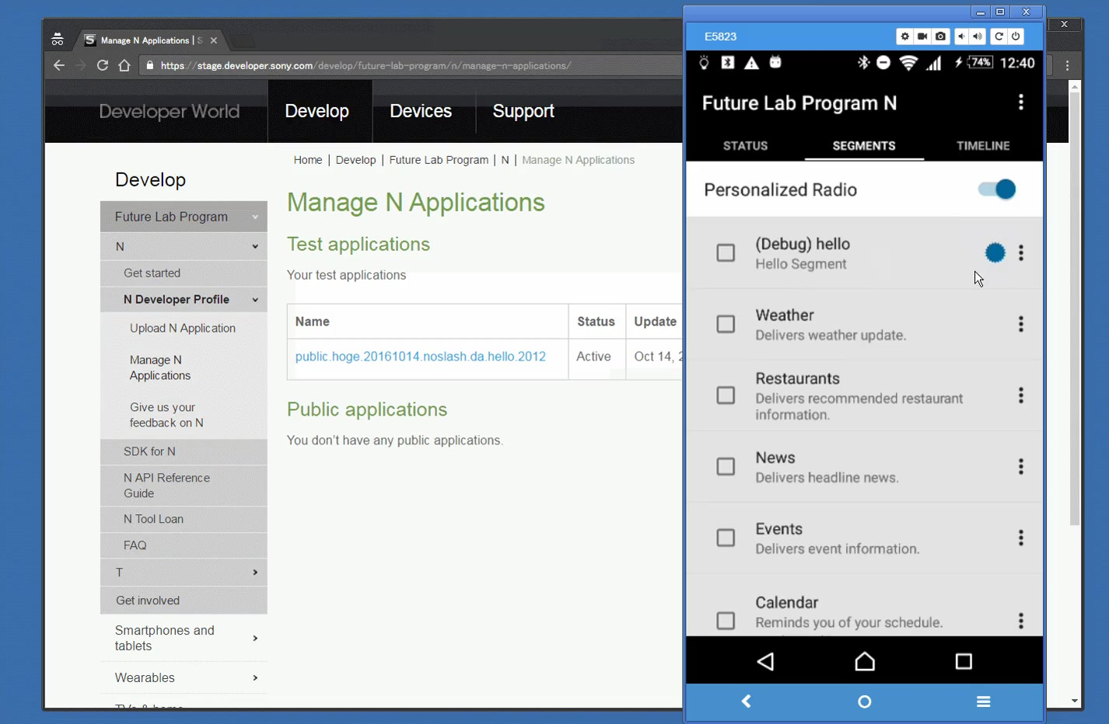
Open Segments List on HostApplication

Slide 46
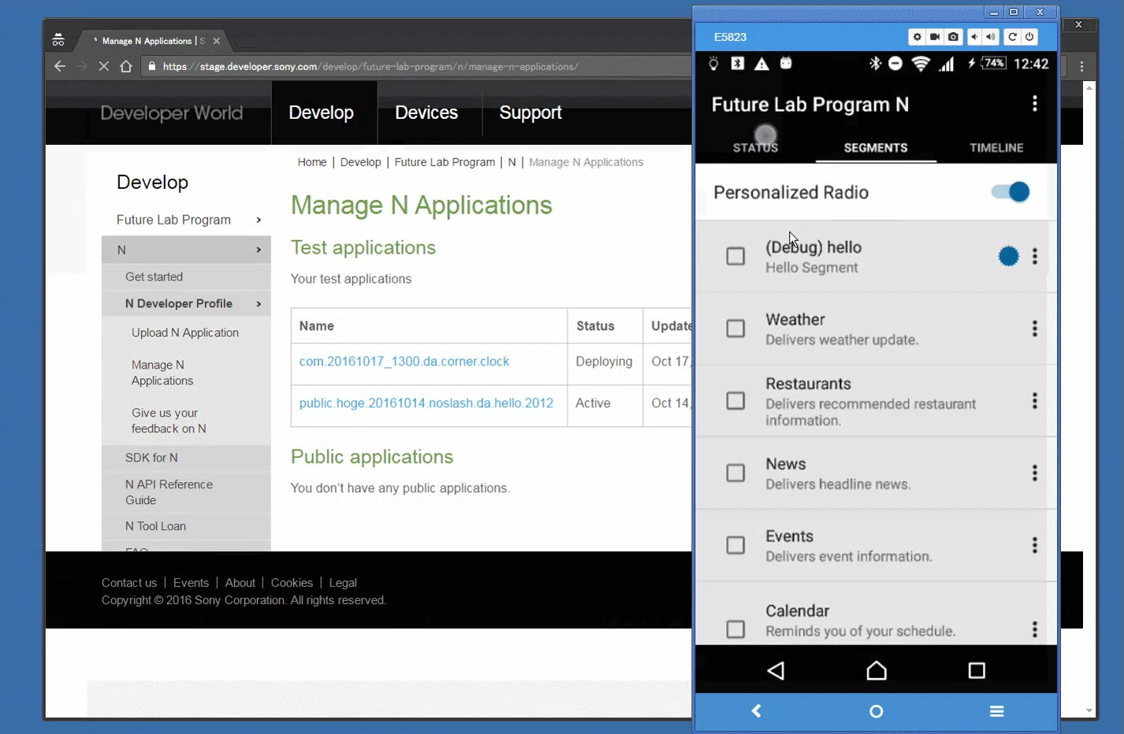
Distribute my segment application on only your device

Slide 47
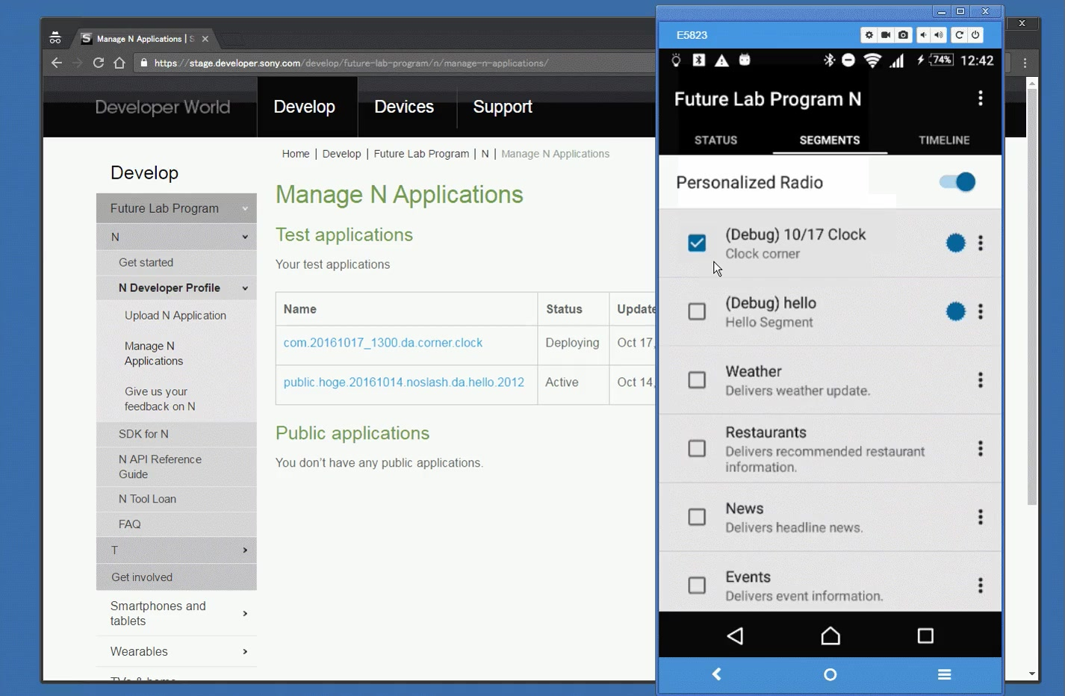
Subscribe(Install) your segment app on your device

Slide 48
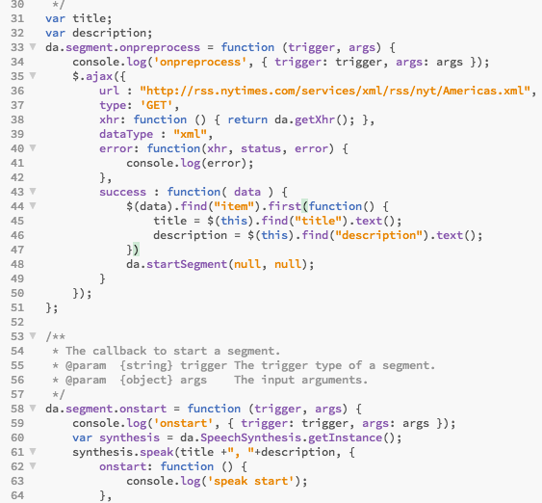
Connect to a web service
Download jQuery to app/jquery.js
Open hello.js and add jQuery
<script language=“Javascript” src=“app/jquery.js”></script>
Modify hello.js to add the code to the left (You can find this code snippet on StackOverflow under the tag “sony-future-lab-n”)

